Slide 1
CS161 – Design and Architecture of Computer Systems
Week 4 - Discussion

Slide 2
Midterm Review
1. (8 points) Compute the CPI for this program on this CPU.
CPI = 0.44*2 + 0.24*4 + 0.12*1 + 0.16*4 + 0.04*4
= 0.88 + 0.96 + 0.12 + 0.64 + 0.16
= 2.76 cycles/instruction
2. (8 points) A new compiler reduces the number of Conditional Branches by half, compute
the new CPI.
new CPI = (0.44*2 + 0.24*4 + 0.12*1 + 0.08*4 + 0.04*4) / 0.92
= (0.88 + 0.96 + 0.12 + 0.32 + 0.16 ) / 0.92
= 2.65 cycles/instruction (regrade?)

Slide 3
Midterm Review
3. (2 points each) Name the three types of pipeline hazards and name three
solutions discussed in class.
Hazards: Solutions 1. Structural Hazard 1. Stall 2. Data Hazard 2. Forwarding 3. Control Hazard 3. Reorder Instructions 4. (8 points) Write the MIPS code corresponding to this C code. Assume i and k correspond to
$s3 and $s5 while the base of the array is at $s6.
While (save[i] == k)
i += 1;
LOOP : sll $t0, $s3, 2 # $t0 = i * 4
add $t0, $t0, $s6 # $t0 = &save[i]
lw $t1, 0($t0) # $t1 = save[i]
bne $t1, $s5, EXIT # if (save[i] != k) goto EXIT
addi $s3, $s3, 1 # i = i + 1
j LOOP # goto LOOP
EXIT:

Slide 4
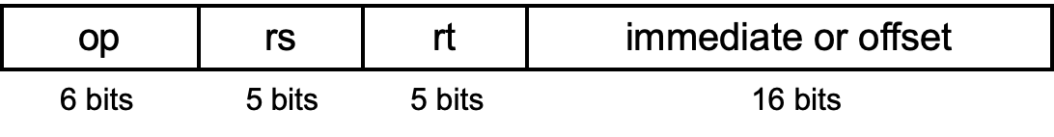
Midterm Review
5. (8 points) Given the MIPS instruction lw $t0, 4($s0) explain how the 32 bits of the instruction
word will be allocated.
lw rt, imm(rs) # rt ← Mem[imm+rs]
lw $t0, 4($s0) # $r0 ← Mem[4+$s0]
[31-26]: opcode (lw)
[25-21]: register source ($s0)
[20-16]: register destination ($t0)
[15-0]: immediate(#4)

Slide 5
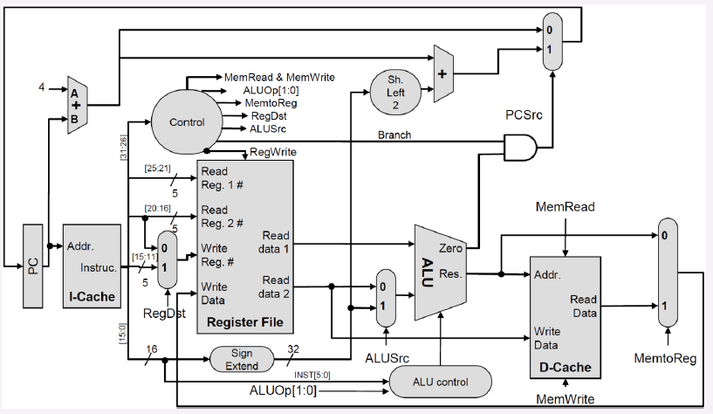
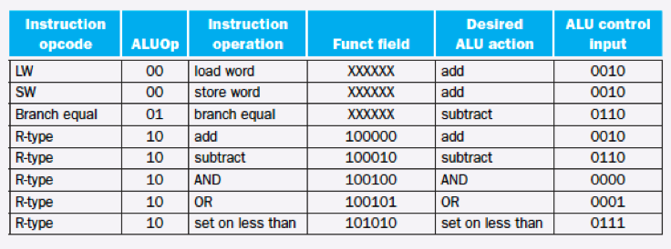
Midterm Review
6. (8 points) Given the MIPS instruction sw R0, 8(R0), determine the necessary control signals.
rs
rt
x
rd
x
x
x

Slide 6
Midterm Review
7. (8 points) Trace the datapath that is active during the sw R0, 8(R0) instructi
rs
rt
rd

Slide 7
Midterm Review
8. (8 points) Separate the following datapath into stages of the pipeline discussed in class. Label each stage clearly.
IF
ID
EX
MEM
WB

Slide 8
Midterm Review
9. (8 points) Map the pipeline schedule for the code below. Assume there is no forwarding
enabled.
With no forwarding enabled (dependencies)
 | 1 | 2 | 3 | 4 | 5 | 6 | 7 | 8 | 9 | 10 | 11 | 12 | 13 | 14 | 15 | 16 | 17 | 18 | 19 | Comments
lw $t1, 0($t0) | F | D | E | M | W
lw $t2, 4($t0) |  | F | D | E | M | W
add $t3, $t1, $t2 |  |  | F | - | - | D | E | M | W |  |  |  |  |  |  |  |  |  |  | Wait on $t2, stall 2 cycles
sw $t3, 12($t0) |  |  |  |  |  | F | - | - | D | E | M | W |  |  |  |  |  |  |  | Wait on $t3, stall 2 cycles
lw $t4, 8($t0) |  |  |  |  |  |  |  |  | F | D | E | M | W
add $t5, $t1, $t4 |  |  |  |  |  |  |  |  |  | F | - | - | D | E | M | W |  |  |  | Wait on $t4, stall 2 cycles
sw $t5, 16($t0) |  |  |  |  |  |  |  |  |  |  |  |  | F | - | - | D | E | M | W | Wait on $t5, stall 2 cycles

Slide 9
Midterm Review
10. (8 points) Map the pipeline schedule for the code below using forwarding when necessary.
With forwarding enabled (dependencies – forwarding)
 | 1 | 2 | 3 | 4 | 5 | 6 | 7 | 8 | 9 | 10 | 11 | 12 | 13 | 14 | 15 | 16 | 17 | 18 | 19 | Comments
lw $t1, 0($t0) | F | D | E | M | W
lw $t2, 4($t0) |  | F | D | E | M | W
add $t3, $t1, $t2 |  |  | F | - | D | E | M | W |  |  |  |  |  |  |  |  |  |  |  | Forward $t2 from Mem/WB to Exec, Stall 1 cycle
sw $t3, 12($t0) |  |  |  |  | F | D | E | M | W |  |  |  |  |  |  |  |  |  |  | Forward $t3 from Exec/Mem to Exec.
lw $t4, 8($t0) |  |  |  |  |  | F | D | E | M | W
add $t5, $t1, $t4 |  |  |  |  |  |  | F | - | D | E | M | W |  |  |  |  |  |  |  | Forward $t4 from Mem/WB to Exec, Stall 1 cycle
sw $t5, 16($t0) |  |  |  |  |  |  |  |  | F | D | E | M | W |  |  |  |  |  |  | Forward $t5 from Exec/Mem to Exec.

Slide 10
CS161 – Design and Architecture of Computer Systems
Chp 5 – Memory
*some slides adapted from:
Prof Daniel Wong UCR – EE/CS)

Slide 11
DRAM vs SRAM
Dynamic Random Access Memory (DRAM)
slowly discharges, need to refresh to preserve
slower → cheaper → larger (can afford more)
Static Random Access Memory (SRAM)
no need to refresh (more transistors to “store”)
much faster than DRAM
faster → expensive → smaller (use less of them)
Storage | Speed | Cost | Capacity | Delay | Cost/GB
Static RAM | Fastest | Expensive | Smallest | 0.5 – 2.5 ns | $1,000’s
Dynamic RAM | Slow | Cheap | Large | 50 – 70 ns | $10’s
Hard disks | Slowest | Cheapest | Largest | 5 – 20 ms | $0.1’s

Slide 12
Latency vs Bandwidth
Latency
time it takes to get something
i.e., time it takes for water to get through the hose
Bandwidth
how much you can get per second
i.e., how much water flowing through hose / sec

Slide 13
Memory Hierarchy
small & fast memory → close to CPU
large & slow memory → further away

Slide 14
Cache
Cache
small, fast, expensive memory
between CPU and main memory
keeps copy of most frequently used data

Slide 15
Locality
Temporal Locality (time)
likely to access same data repeatedly over time
i.e., for loops
Spatial Locality (space/area)
likely to access data close together in memory
i.e., array element accesses / instructions

Slide 16
Simple Cache Design
Memory
Address
(decimal)
but how do we know which memory address is in the cache?
0000
0001
0010
0011
0100
0101
0110
0111
1000
1001
1010
1011
1100
1101
1110
1111
(0)
(1)
(2)
(3)
(4)
(5)
(6)
(7)
(8)
(9)
(10)
(11)
(12)
(13)
(14)
(15)
Cache
index
(decimal)
Data
00
01
10
11
(0)
(1)
(2)
(3)
cache is smaller than memory so use hash function to map memory to the cache

Slide 17
Adding Tags
Need to add tags to cache to:
distinguish between different memory locations that map to same cache block
0000
0001
0010
0011
0100
0101
0110
0111
1000
1001
1010
1011
1100
1101
1110
1111
Index
Tag
Data
00
01
10
11
00
11
01
01

Slide 18
Putting it Together
Concatenating:
cache block tags
block indices
Gives us address in main memory
Main memory
address in cache block
Index
Tag
Data
00
01
10
11
00
11
01
01
00 + 00 = 0000
11 + 01 = 1101
01 + 10 = 0110
01 + 11 = 0111

Slide 19
Valid Bit
At start → cache is empty (no valid data)
When system is initialized, all valid bits are set to 0
When data loaded into a cache block:
corresponding valid bit is set to 1
So cache has bits to help find data within cache and verify validity
Valid
Bit
Main memory
address in cache block
Index
Tag
Data
00
01
10
11
1
0
0
1
00
11
01
01
00 + 00 = 0000
Invalid
???
???

Slide 20
Reading From Cache (cache hit)
Lowest k bits of the block address will index a block in the cache
block is valid (valid bit set)
tag matches upper (m - k) bits of m-bit address
data sent to CPU
Address (32 bits)
Index
Valid
Tag
Data
0
1
2
3
...
...
1022
1023
22
10
Index
To CPU
Tag
Hit
=
32-bit memory address and a 2¹⁰-byte cache (2¹⁰=1024)

Slide 21
Loading Block Into Cache
After data read from main memory, putting a copy of that data into the cache is straightforward.
The lowest k bits of the block address specify a cache block
The upper (m - k) address bits are stored in the block’s tag field
The data from main memory is stored in the block’s data field
The valid bit is set to 1
Address (32 bits)
Index
Valid
Tag
Data
0
1
2
3
...
...
...
22
10
Index
Tag
Data
1

Slide 22
Cache Sets and Ways
n-ways: number of blocks per line
cache line
block
Sets: number of
cache lines
n-way set associative

Slide 23
Cache Sets and Ways: Example
(0)
(1)
(2)
(3)
(4)
(5)
(6)
(7)
(8)
(9)
(10)
(11)
(12)
(13)
(14)
(15)
n-ways: number of blocks per line
block
team 1
Memory
Address
(decimal)
Sets: number of
cache lines
team 2
team 3
team 4
n-way set associative
n toilets/team
Example: Summer Camp!
Students go to summer camp (each student is a memory location)
Campers are grouped by teams and given a different color shirt (colors above)
(each shirt color is different collection of memory locations)
Each team is assigned to a different bathroom facility
(each set is different team’s bathroom, each team hashed to cache-line/bathroom)
Each bathroom has same number individual toilet stalls
(n = # toilets/team)

Slide 24
Direct-mapped Cache
1-way
block/line
Direct mapped cache
- Each block maps to only one cache line
- aka “1-way set associative”
16 Sets
Example:
Cache size = 16 blocks
1-way
16-sets
1-way set associative

Slide 25
Direct-mapped Cache: Example
(0)
(1)
(2)
(3)
(4)
(5)
(6)
(7)
(8)
(9)
(10)
(11)
(12)
(13)
(14)
(15)
1-way
block/line
team 1
4 Sets
team 2
team 3
team 4
1 toilet/team
Example: Summer Camp!
only one toilet per team → a lot of “conflicts”

Slide 26
Set Associative Cache
4-way
block
4 Sets
Example:
Cache size = 16 blocks
4-ways
4-sets
4-way set associative

Slide 27
Cache Sets and Ways: Example
(0)
(1)
(2)
(3)
(4)
(5)
(6)
(7)
(8)
(9)
(10)
(11)
(12)
(13)
(14)
(15)
n-ways: number of blocks per line
block
team 1
Memory
Address
(decimal)
Sets: number of
cache lines
team 2
team 3
team 4
n-way set associative
4 toilets/team
Example: Summer Camp!
four toilets per team → less “conflicts”

Slide 28
Fully Associative Cache
16-ways
1 Sets
block /line
Fully Associative
- Each block can be mapped to any cache line
- aka “m-way set associative”
(where m = number of cache blocks)
Example:
Cache size = 16 blocks
16-way
1-set
16-way set associative
(fully associative)

Slide 29
Fully Associative Cache: Example
(0)
(1)
(2)
(3)
(4)
(5)
(6)
(7)
(8)
(9)
(10)
(11)
(12)
(13)
(14)
(15)
Memory
Address
(decimal)
16-ways
1 Set
16 toilets
Example: Summer Camp!
only one bathroom, but a more toilets in the bathroom

Slide 30
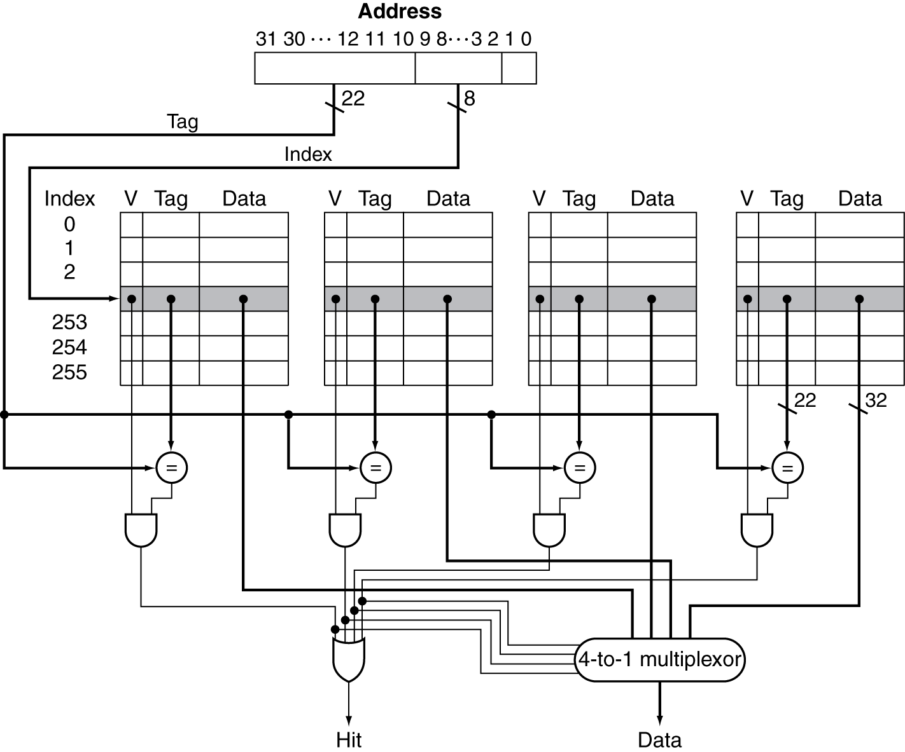
Set Associative Cache Organization

Slide 31
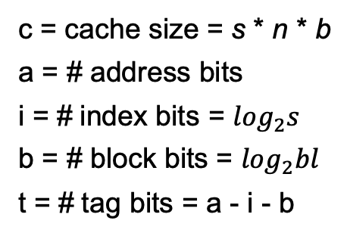
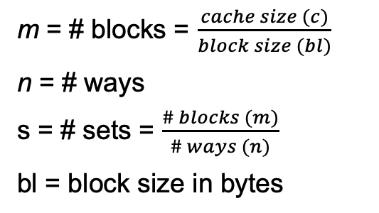
Cache Addressing
n-Ways: Block can go anywhere in cache line
cache line
s-Sets: Block mapped by address
(index)
block
Tag bits (remainder) t = a-i-b | Index bits (sets) i = log₂s | Offset bits (block) b = log₂bl
Address
m = # blocks = $\frac{cache size (c)}{block size (bl)}$
n = # ways
s = # sets = $\frac{\# blocks (m)}{\# ways (n)}$
bl = block size in bytes
c = cache size = s * n * b
a = # address bits
i = # index bits = $\log_{2}s$
b = # block bits = $\log_{2}bl$
t = # tag bits = a - i - b

Slide 32
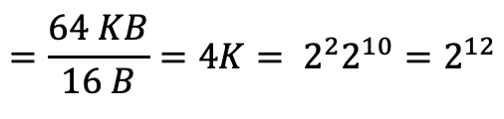
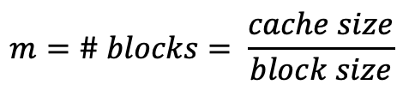
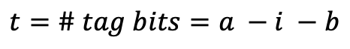
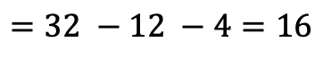
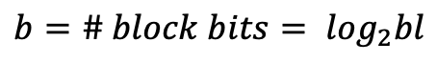
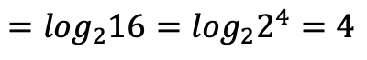
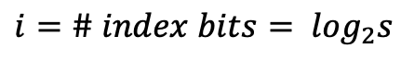
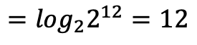
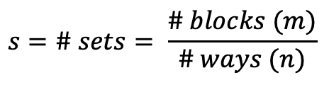
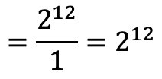
Cache Addressing: Example 1
Ex. 64KB cache, direct mapped, 16 B block
Address
Tag bits (remainder) t = a-i-b | Index bits (sets) i = log₂s | Offset bits (block) b = log₂bl
16 12 4
$$m=\# blocks= \frac{cache size}{block size}$$
$$=\frac{64 KB}{16 B}=4K= 2^{2}2^{10}=2^{12}$$
1-way
$$s=\# sets= \frac{\# blocks (m)}{\# ways (n)}$$
$$=\frac{2^{12}}{1}=2^{12}$$
block/line
sets
$$i=\# index bits= \log_{2}s$$
$$=\log_{2}2^{12}=12$$
$$b=\# block bits= \log_{2}bl$$
$$=\log_{2}16=\log_{2}2^{4}=4$$
$$t=\# tag bits=a −i −b$$
$$=32 −12 −4=16$$
Notes:
4k sets = 2^12

Slide 33
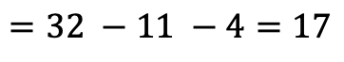
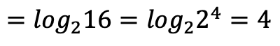
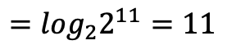
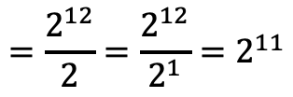
Cache Addressing : Example 2
Ex. 64KB cache, 2-way associative, 16 B block
Address
Tag bits (remainder) t = a-i-b | Index bits (sets) i = log₂s | Offset bits (block) b = log₂bl
17 11 4
$$m=\# blocks= \frac{cache size}{block size}$$
$$=\frac{64 KB}{16 B}=4K= 2^{2}2^{10}=2^{12}$$
cache line
2-way
block
$$s=\# sets= \frac{\# blocks (m)}{\# ways (n)}$$
$$=\frac{2^{12}}{2}=\frac{2^{12}}{2^{1}}=2^{11}$$
sets
$$i=\# index bits= \log_{2}s$$
$$=\log_{2}2^{11}=11$$
$$b=\# block bits= \log_{2}bl$$
$$=\log_{2}16=\log_{2}2^{4}=4$$
$$t=\# tag bits=a −i −b$$
$$=32 −11 −4=17$$
Notes:
4k sets = 2^12

Slide 34
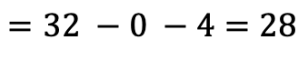
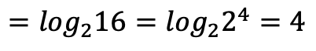
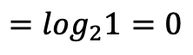
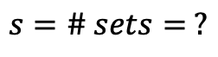
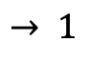
Cache Addressing : Example 3
Ex. 64KB cache, fully associative, 16 B block
Address
Tag bits (remainder) t = a-i-b | Index bits (sets) i = log₂s | Offset bits (block) b = log₂bl
28 0 4
$$m=\# blocks= \frac{cache size}{block size}$$
$$=\frac{64 KB}{16 B}=4K= 2^{2}2^{10}=2^{12}$$
cache line
$$s=\# sets= ?$$
$$→ 1$$
fully assoc.
sets
block
$$i=\# index bits= \log_{2}s$$
$$=\log_{2}1=0$$
$$b=\# block bits= \log_{2}bl$$
$$=\log_{2}16=\log_{2}2^{4}=4$$
$$t=\# tag bits=a −i −b$$
$$=32 −0 −4=28$$
Notes:
4k sets = 2^12

Slide 35

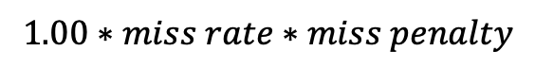
Measuring Cache Performance
$$memory stall cycles= \frac{memory accesses}{program}∗miss rate∗miss penalty$$
When do we access memory?
Instruction Fetch (I$)
Data (D$)
Load
Store
$$1.00∗miss rate∗miss penalty$$
$memory stall cycles (I\$)=$
$$\frac{num loads/stores}{num instructions}∗miss rate∗miss penalty$$
$$memory stall cycles \left(D\$\right)=$$

Slide 36
Cache Performance: Example
Example:
Given:
I-cache miss rate = 2%
D-cache miss rate = 4%
Miss penalty = 100 cycles
Base (“ideal) CPI = 2
Load & stores are 36% of instructions
Miss cycles (penalty) per instruction
I-cache:
D-cache:
Actual CPI =
Speedup:
Ideal CPU is times faster
0.02 × 100 = 2
0.36 × 0.04 × 100 = 1.44
2 + 2 + 1.44 = 5.44
5.44/2 =2.72

Slide 37
Write-Through
On data-write hit, could just update the block in cache
But then cache and memory would be inconsistent
Write through: also update memory
But makes writes take longer
e.g., if base CPI = 1, 10% of instructions are stores, write to memory takes 100 cycles
Effective CPI = 1 + 0.1×100 = 11
Solution: write buffer
Holds data waiting to be written to memory
CPU continues immediately
Only stalls on write if write buffer is already full

Slide 38
Write-Back
Alternative: On data-write hit, just update the block in cache
Keep track of whether each block is dirty
When a dirty block is replaced
Write it back to memory
Can use a write buffer to allow replacing block to be read first

Slide 39
Write Allocation
What should happen on a write miss?
Alternatives for write-through
Allocate on miss: fetch the block
Write around: don’t fetch the block
Since programs often write a whole block before reading it (e.g., initialization)
For write-back
Usually fetch the block

